Slide 1
Visit Amsterdam, See Holland
Boudewijn Bokdam, Amsterdam Marketing
Notes:
Introduction

Slide 2
Target groups
Visitors
The soul of the city
Visitors
The soul of the city
Business
Residents
Notes:
AM is the citymarketing organization of the amsterdam metropolitan area; focusing on promoting amsterdam towards 3 target groups. These make up the soul of the city. In order to be a sustainable destination, there should be a right balance in between the three of them
However, currently there is no right balance. Intense politcal discussions about the number of visitors. So, we are looking to find ways how to try and minmize the negative impacts

Slide 3
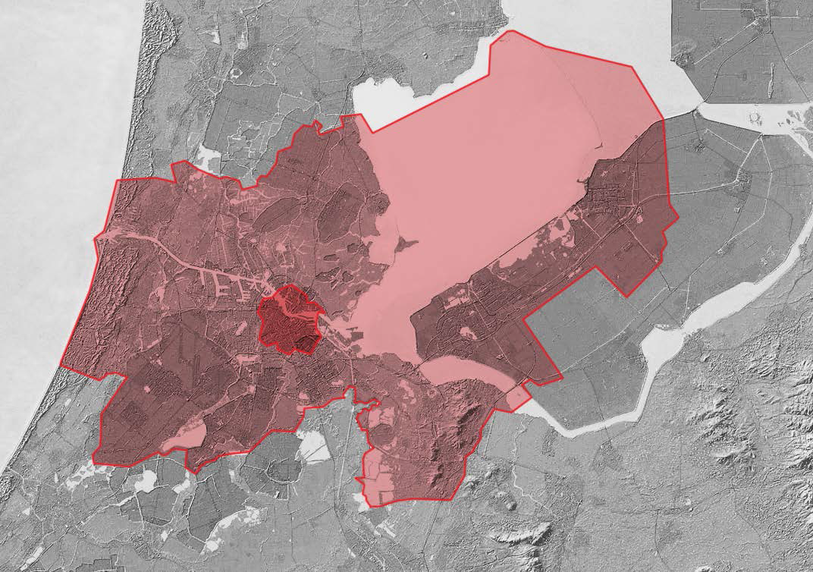
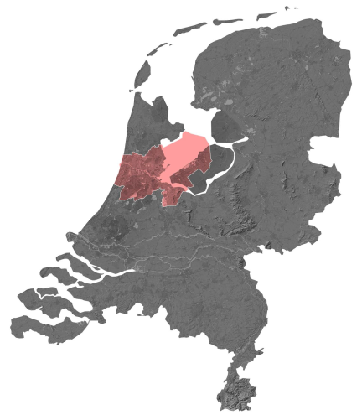
Region
Amsterdam
Amsterdam
Notes:
One of the solutions is the spreading of visitors over a bigger area. We therefor started a project which aims to stimulate international visitors from the city centre towards the surrounding region. In order to achieve this, we decided to call the region ‘Amsterdam’ as well, linking it to the destination of Amsterdam

Slide 4
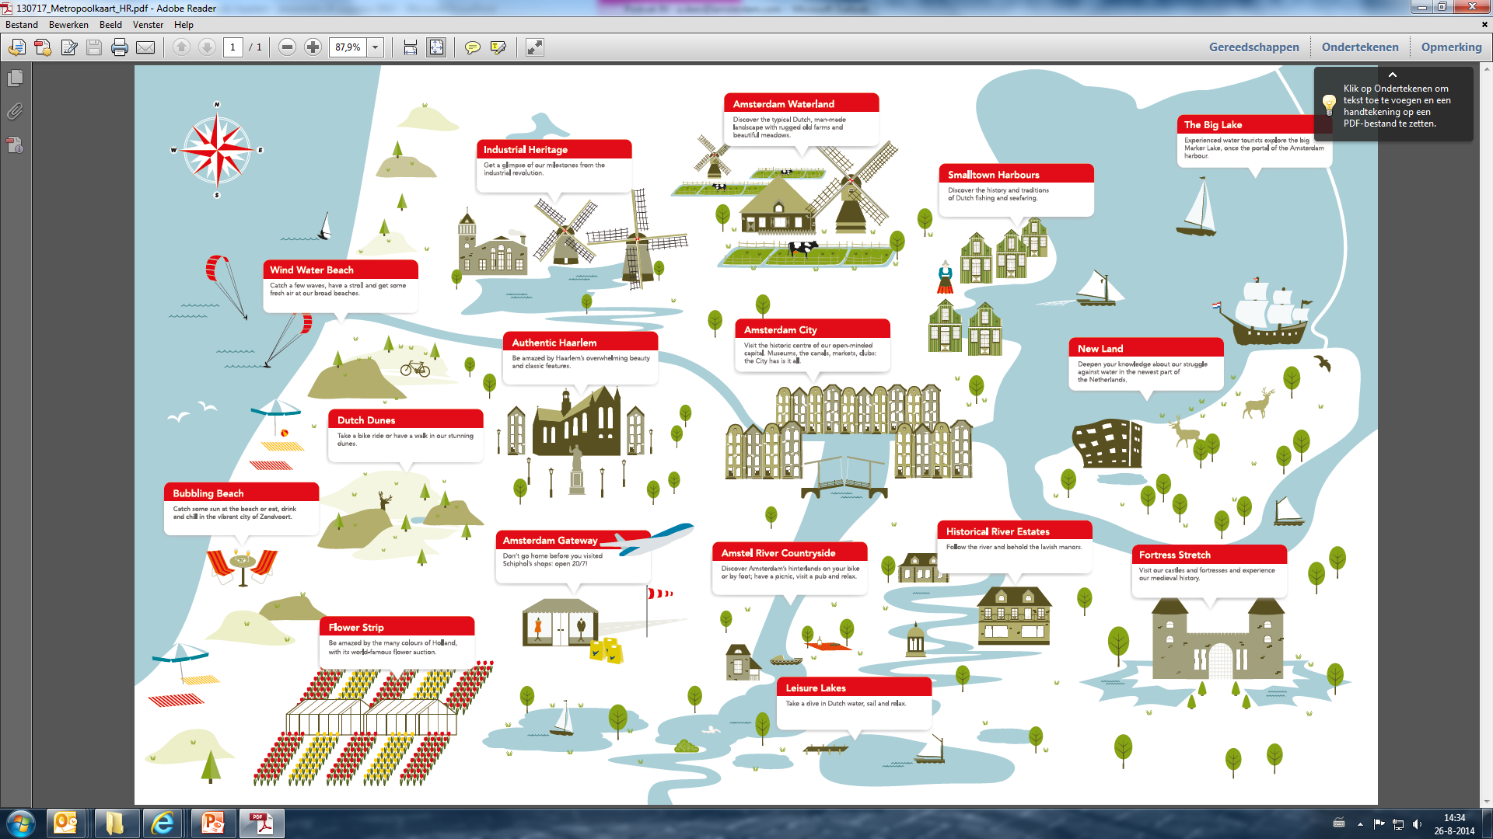
Old Holland
New Land
Amsterdam Beach
Haarlem
Amsterdam
Flowers of Amsterdam
Castles and Gardens of Amsterdam
Notes:
The first thing we did was to bring focus in the marketing and also show the diversity of the region. And this is what we came up with. A sustainable and integrated marketing concept for the whole destination Amsterdam. 16 areas were created into characters in order to improve the product. And to market Amsterdam abroad a layer of 6 themes was introduced, keeping the interests of the visitor in mind.
The development of this took more than a year to realize, because we wanted to have a sustainable concept and have the backing and support of all key stakeholders

Slide 5
Muiderslot Castle
Amsterdam Castle Muiderslot
Number foreign visitors doubled
Notes:
I want to share two practical examples.
1. Muiderslot Castle is located in the village of Muiden, 15 minutes from the city centre of Amsterdam.
The castle decided in 2010 to give the Muiderslot a new international name in its promotion, linking it to the destination Amsterdam: Amsterdam Castle Muiderslot.
The name change proved to be the linking pin for attracting more international visitors out of Amsterdam. By using its name as a reference to Amsterdam, the perception of distance became smaller.
The result? The number of international visitors to the Muiderslot more than doubled since the name change.

Slide 6
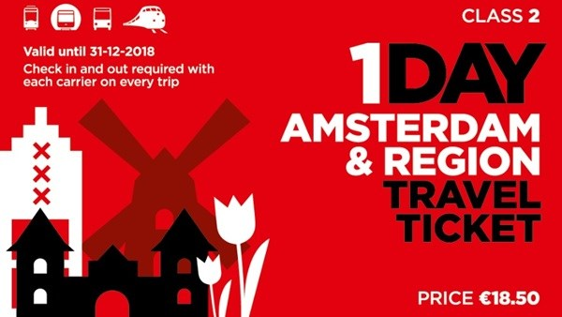
Public transport
One public transport ticket for Amsterdam & Region
Branded buslines
Notes:
2. In order to stimulate visitors to explore the region it is necessary to have an easy to use public transport network in place. Therefor we have been working with public transport companies to remove barriers. We developed 1 public transport ticket which can be used in Amsterdam ánd region (bus, tram, metro, train) for 1 fixed price.
To make the region more accessible, the branding of bus lines can help to realize this goal. We would like to present to you the inspiring example of bus line 391. This is the bus line that departs Amsterdam Central Station to the Zaanse Schans, one of the most populair attractions in The Netherlands. Until 2011 the bus line was known as bus line 391. The public transport company decided to link the name of the bus line to the character of that area: Industrial Heritage. The result? The number of foreign passengers on the bus increased by 93% and the frequency of the busses increased, which improved the amenities for the inhabitants.

